Slide 1
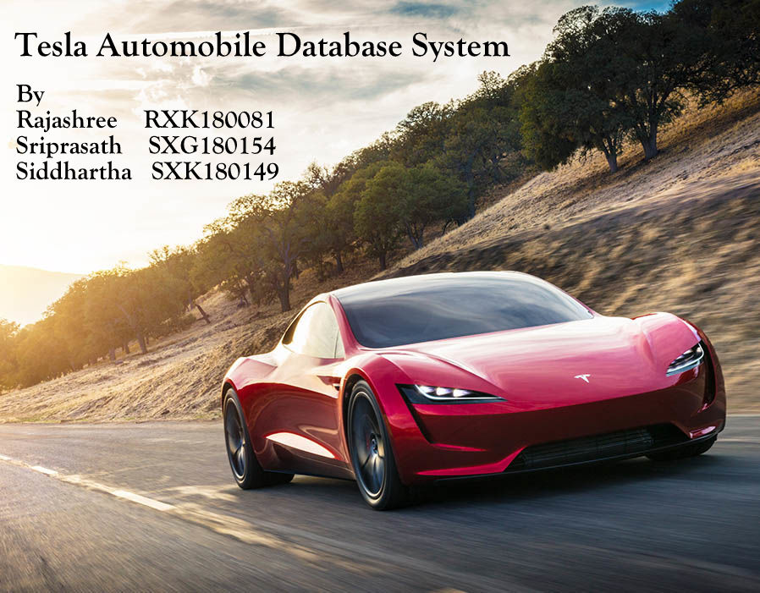

Slide 2
Contents
Introduction
ER Diagram
Relational Schema
Normalization
Triggers
Stored Procedures
NOSQL Incorporation

Slide 3
Introduction
Tesla is one of the leading automotive and energy based company. Tesla’s mission is to accelerate the world’s transition to sustainable energy. It builds not only all-electric vehicles but also infinitely scalable clean energy generation. The web portal enables customer to place order (customized order) on vehicles, accessories, batteries and solar panels. The objective of this project is to design a database for the TESLA System.
A research was conducted to analyze various departments like procurement, production planning, manufacturing, logistics and marketing. We have decided to design the manufacturing sector of the company since that will be the most challenging part which deals with processing orders, maintaining inventory and warehouse while manufacturing vehicles

Slide 4
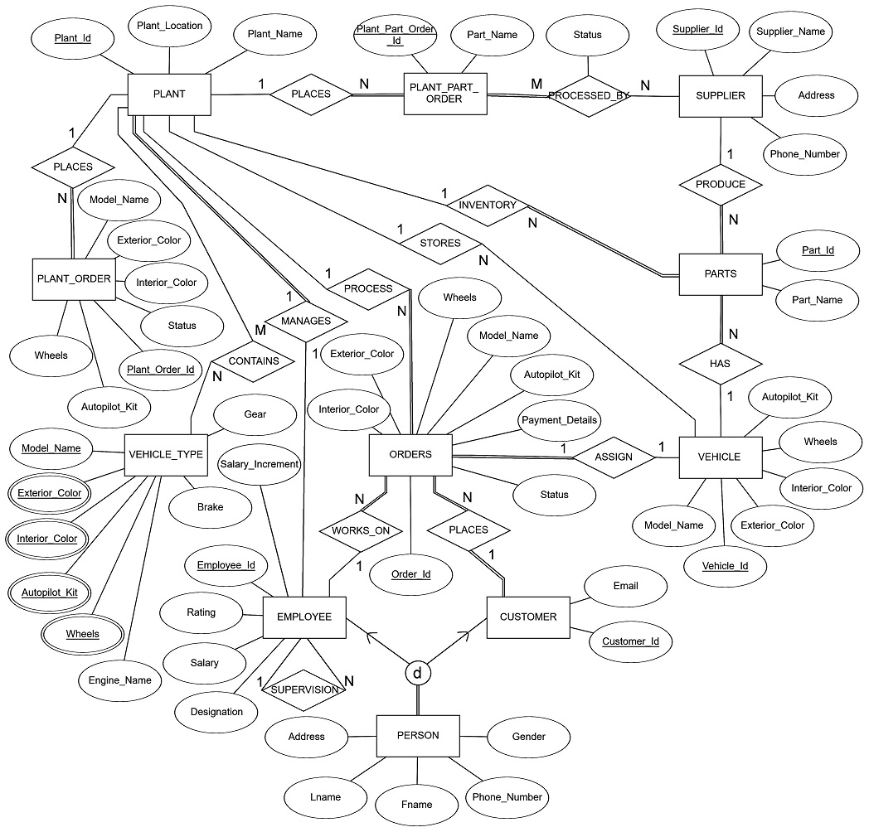
ER Diagram

Slide 5
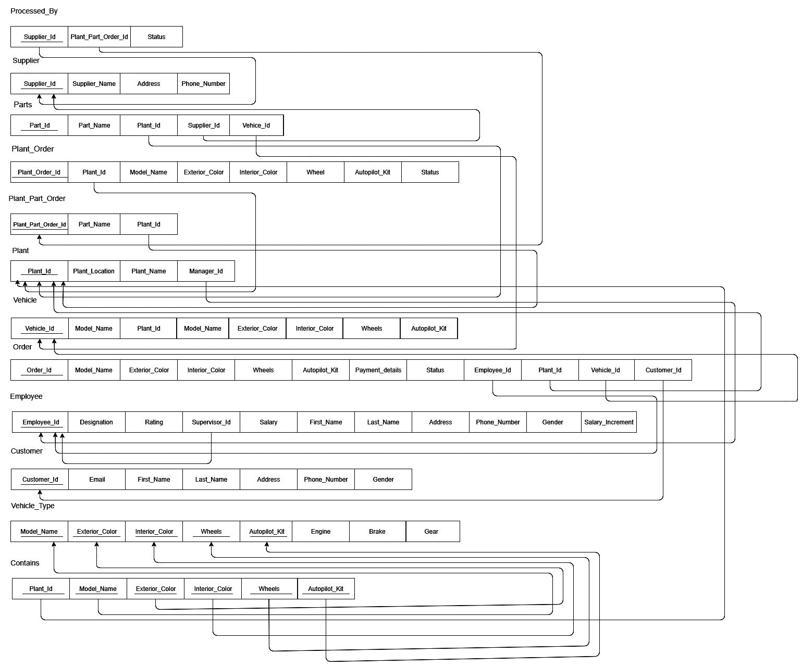
Relational Schema

Slide 6
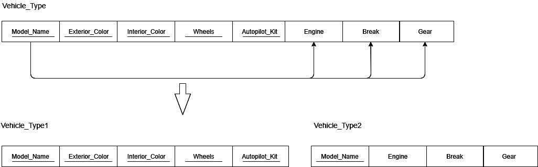
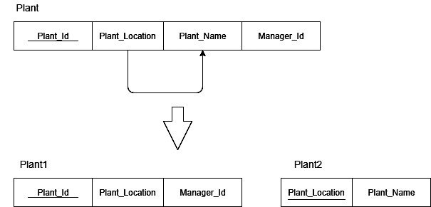
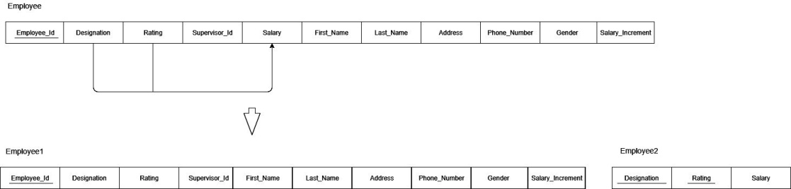
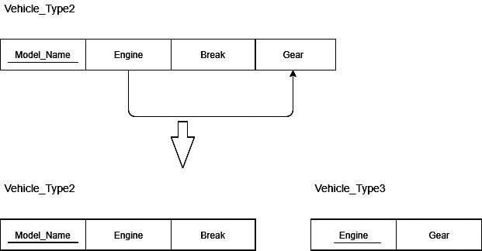
Normalization
2NF
3NF

Slide 7
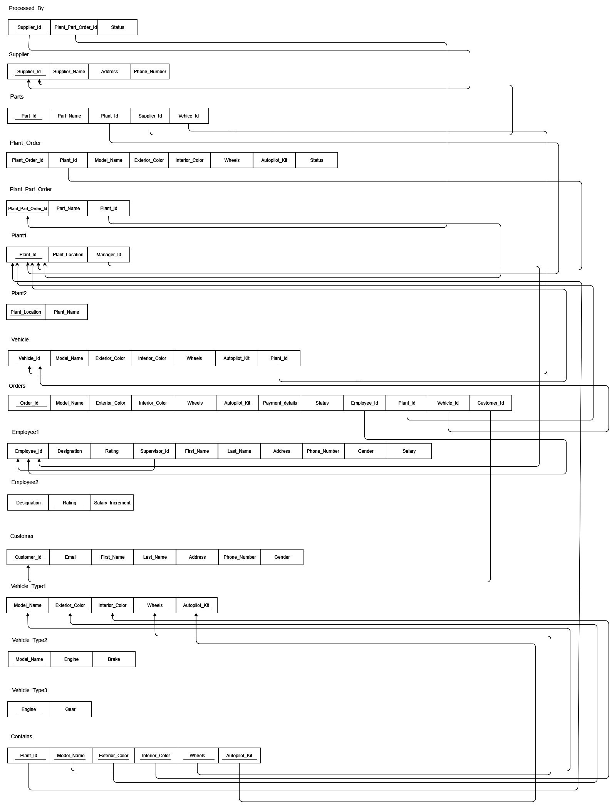

Slide 8
Triggers
Trigger on inserting Order
Checks the given vehicle specifications in VEHICLE table if matched assign VID to inserted order and change the status to delivered else change the status to pending.
Trigger on updating Employee Rating
Check the given rating and increment salary of the Employee.
Trigger on deleting Parts
Whenever a part is deleted we update in the part log for future reference.
Trigger on inserting Plant Order
Check the given vehicle specifications in VEHICLE_TYPE table if matched assign PLANT_ID to inserted order else we display “No model is available with given specifications”

Slide 9
Stored Procedures
Accident Report :
Given order Id and part Name we can fetch supplier Id who supplied that part this might be useful during insurance claims or accidents.
Inventory Details
Given Plant Id it will fetch the entire inventory of that plant.
Supplying Parts to Inventory :
Stored procedure for fulfilling the plant part orders by a supplier.

Slide 10
NOSQL Incorporation
MongoDB a document type database is used to store the combined logs.
ORDERS table and PARTS table from SQL developer are combined and connected to the TESLA_LOGS collection in MongoDB
Results of TESLA_LOGS collection which has the logs of all used parts and delivered vehicle details.

